Slide 1
Microsoft Entra ID
Lecturer: Ngo Huy Bien
Software Engineering Department
Faculty of Information Technology
VNUHCM - University of Science
Ho Chi Minh City, Vietnam
nhbien@fit.hcmus.edu.vn

Slide 2

Objectives

Slide 3

Contents

Slide 4

References

Slide 5
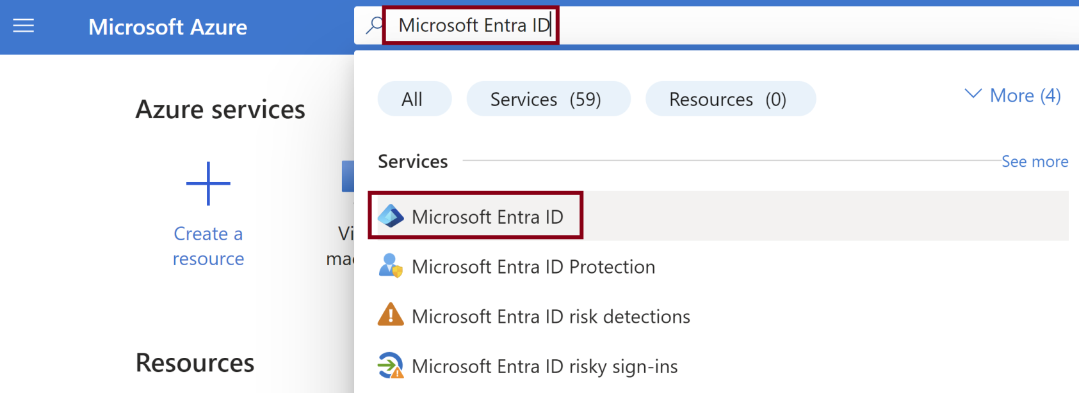
1. Open Microsoft Entra ID

Slide 6
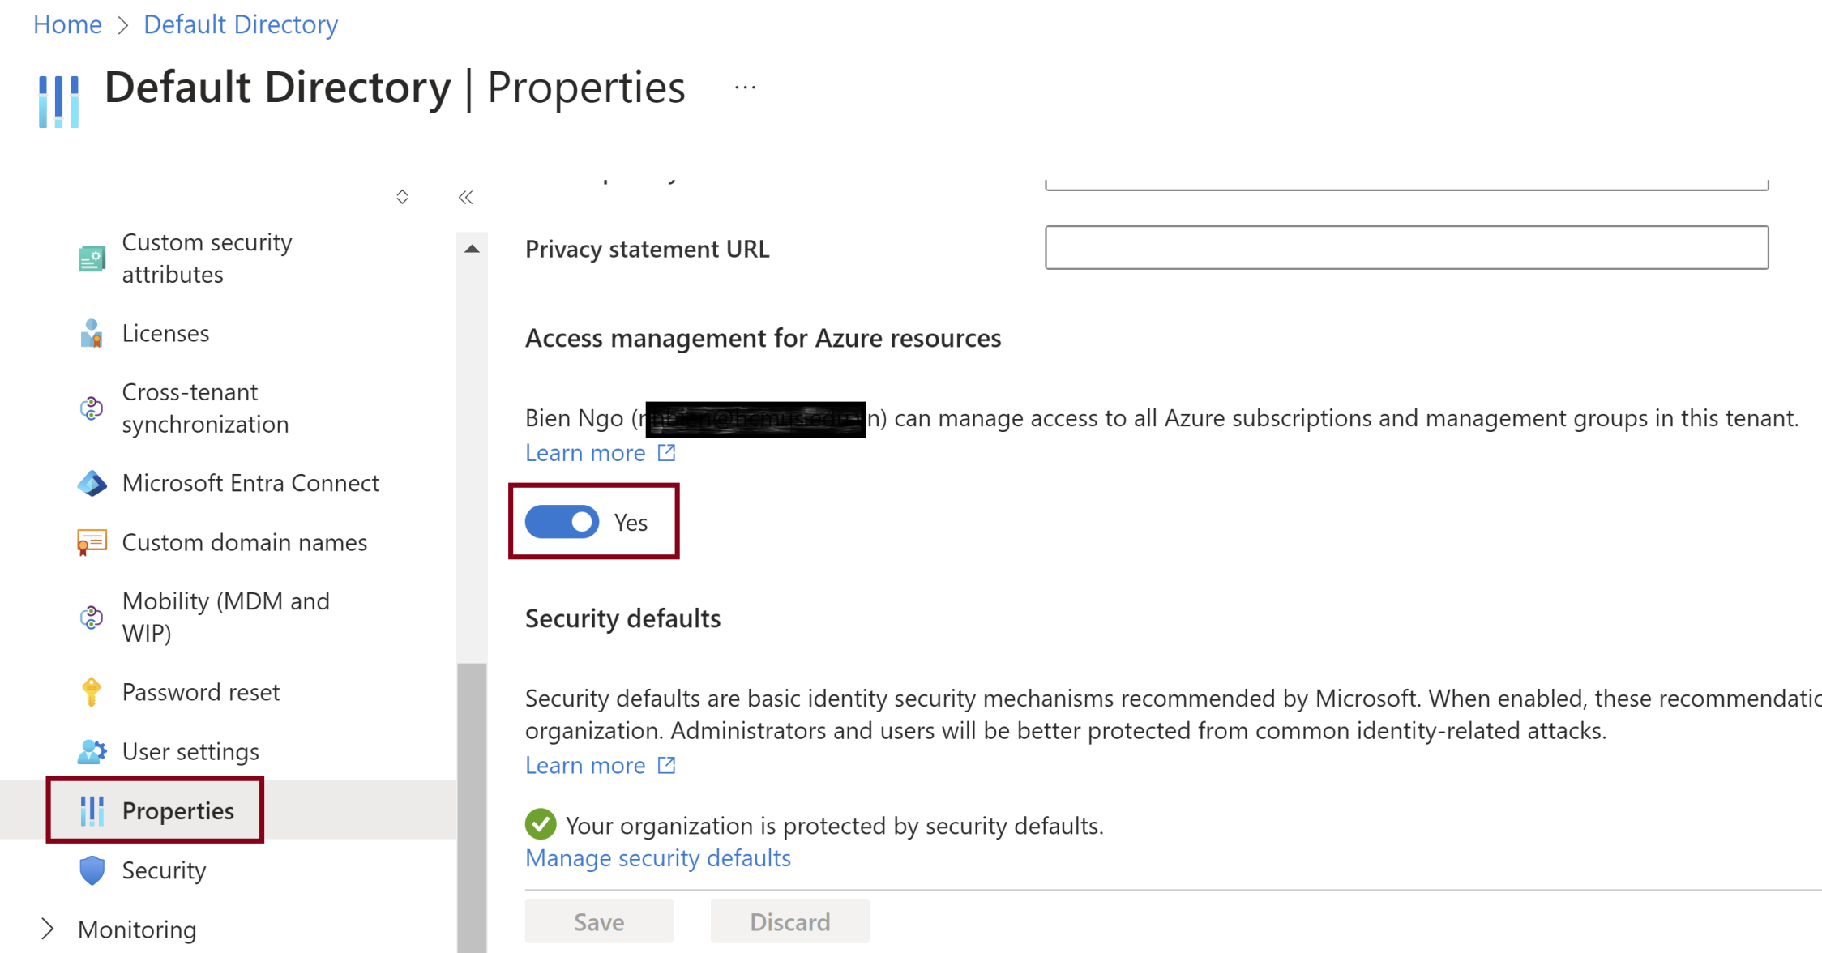
2. Elevate access for a Global Administrator

Slide 7
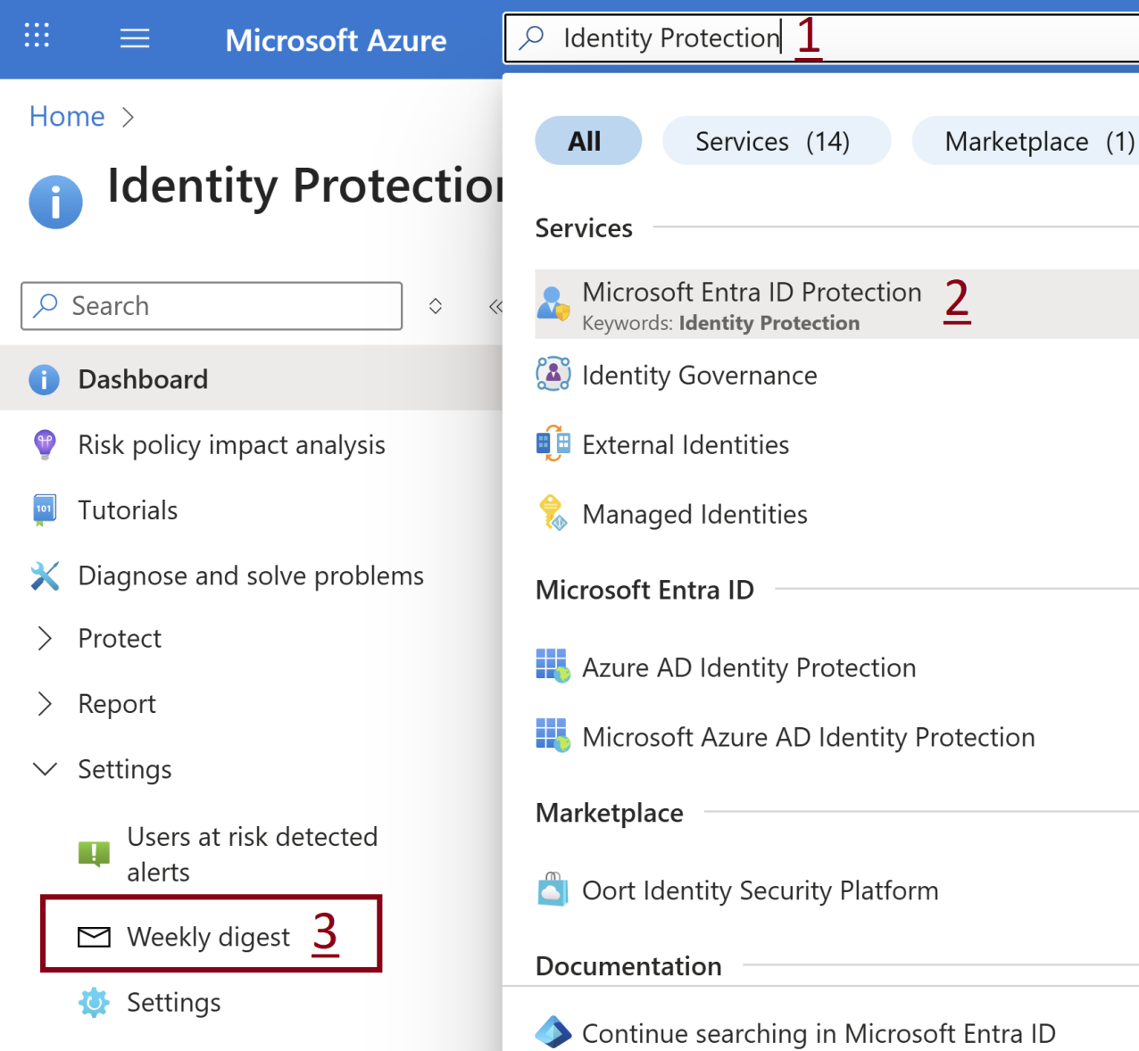
3. Open Entra ID Weekly Digest
Search for Identity Protection.

Slide 8
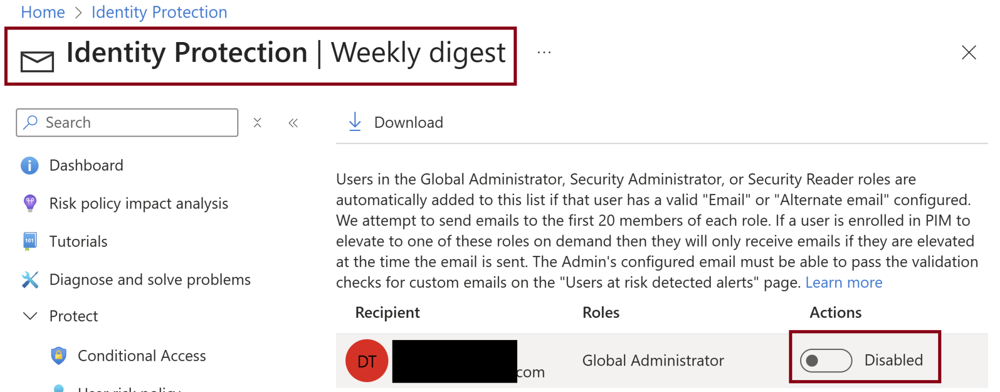
4. Turn off Weekly Digest Emails
Disable weekly digest emails for individuals.

Slide 9
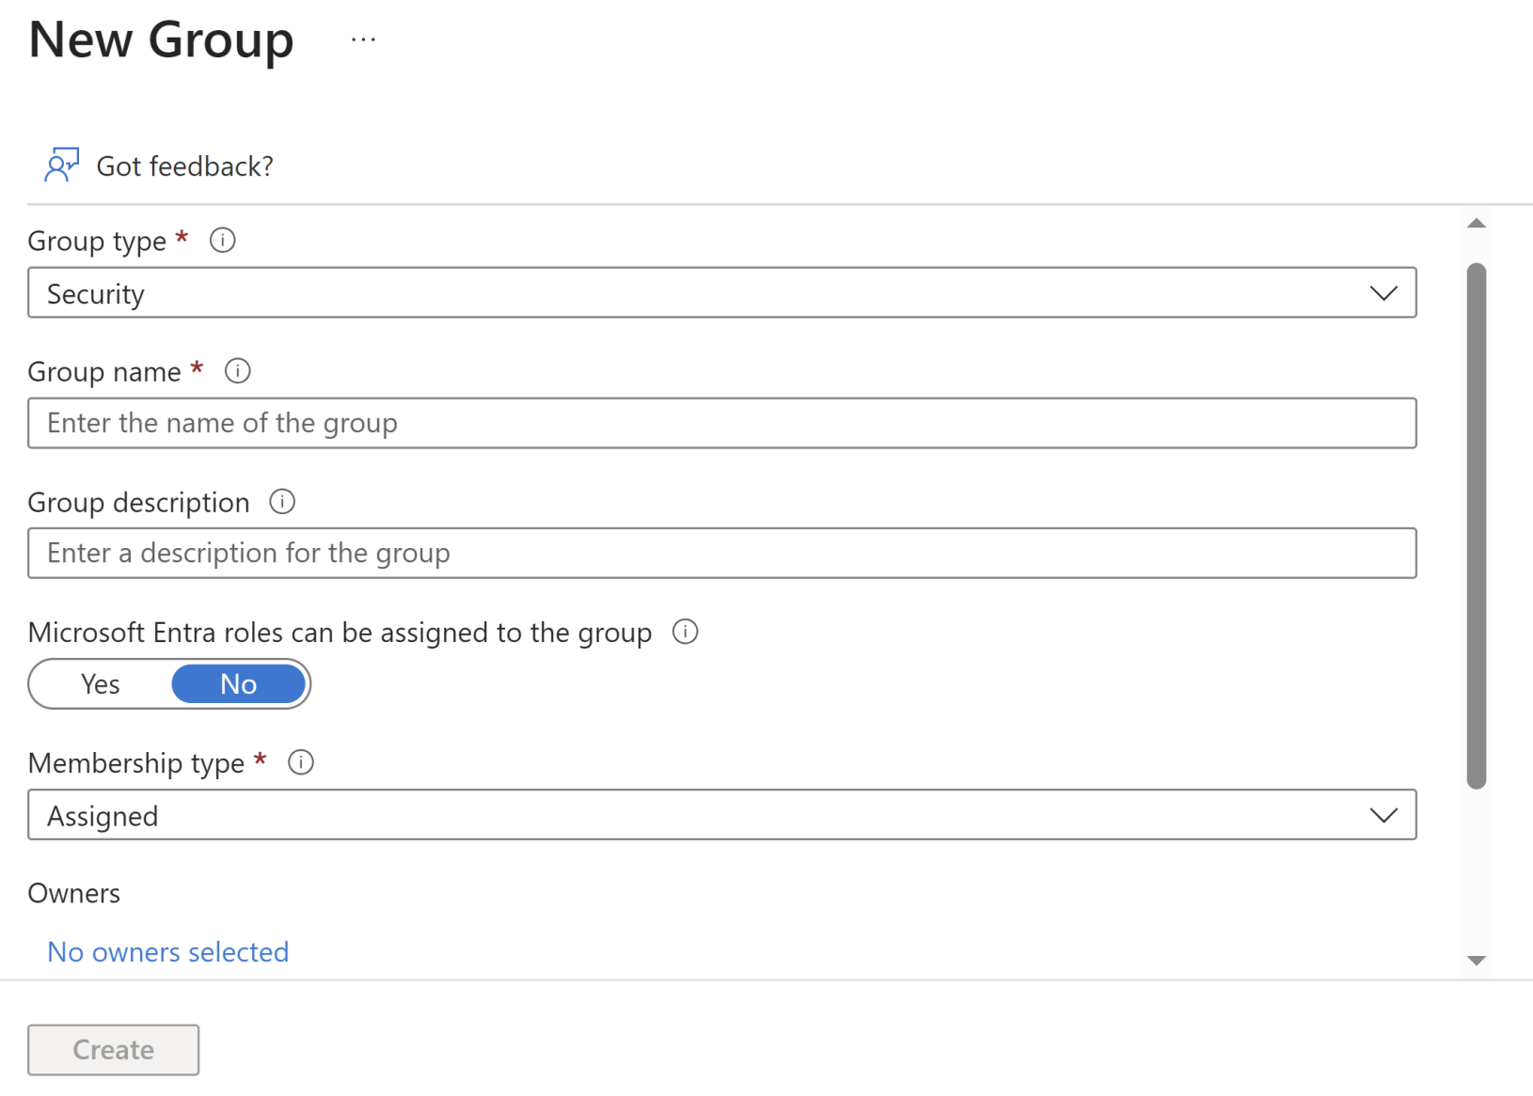
5. Create a New Group

Slide 10

Thank You & See You Again

